Slide 1
AppFabricand Windows Workflow 4
Ron Jacobs
Sr. Technical Evangelist
Microsoft
http://blogs.msdn.com/rjacobs

Slide 2
What is WF4?
WF4 provides declarative authoring of programs that coordinate work
Activities
Runtime
Tooling
Host (.exe, Dublin-IIS/WAS, .NET Services, …)
Workflow
Activity Library
WF Runtime
Extensions
Persistence
Tracking
…
Tooling
VS Designer
VS Debugger
Rehosted Designer

Slide 3
WF4 is a Runtime
Activity
Object
Instruction
WF4
CLR
CLR

Slide 4
Why?
Declarative
Agility
Safety
Memory
WF4
CLR
CLR

Slide 5
Why Declarative?
80 cores in 2011?
Focus on What not How
How do I allocate memory?
How do I avoid race conditions?
“…a leading computer scientist has warned that an easy solution to programming chips with dozens of processors has not yet been discovered.”
- New York Times

Slide 6
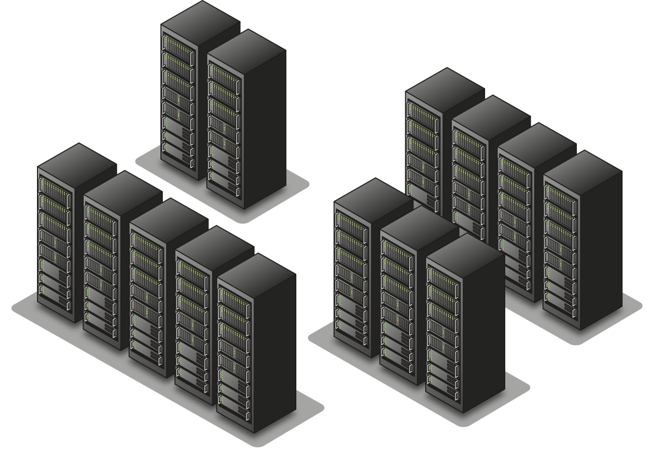
Why Agile?
Work should happen when data is ready where resources are available
Work must be agile across 4 dimensions
Thread
Process
Machine
Time

Slide 7
Customize The Vocabulary
You decide what operations are allowed
Provide high level operations
Assemble into a workflow

Slide 8
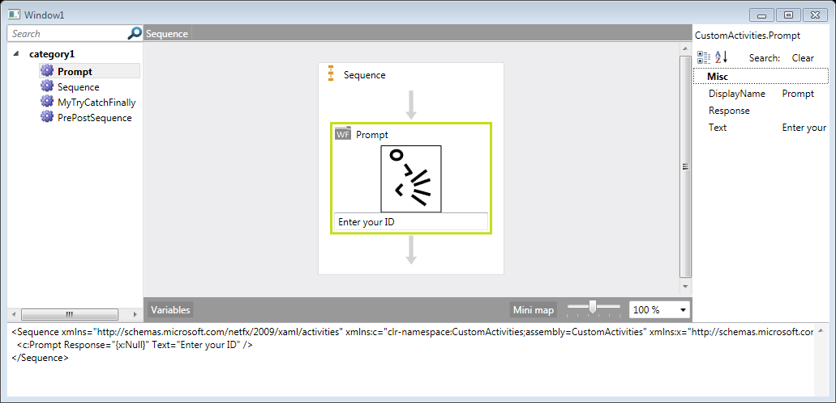
Customize Design

Slide 9
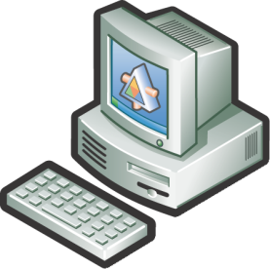
Workflow Everywhere
Client
WF4
WF4
WF4
ASP.NET
AppFabric

Slide 10
Application Server Concepts
SERVERS
SERVICES
Applications
Developer Tools
Programming Model
Application Services
Relational Database
Operating System
Systems Management

Slide 11
Activities
Base Activity Library
Messaging
Primitives
Error Handling
Custom
Control Flow Activities
Flowchart
Sequential
State Machine
Rules
Activity Model & Runtime

Slide 12
Hello Workflow
Demo

Slide 13
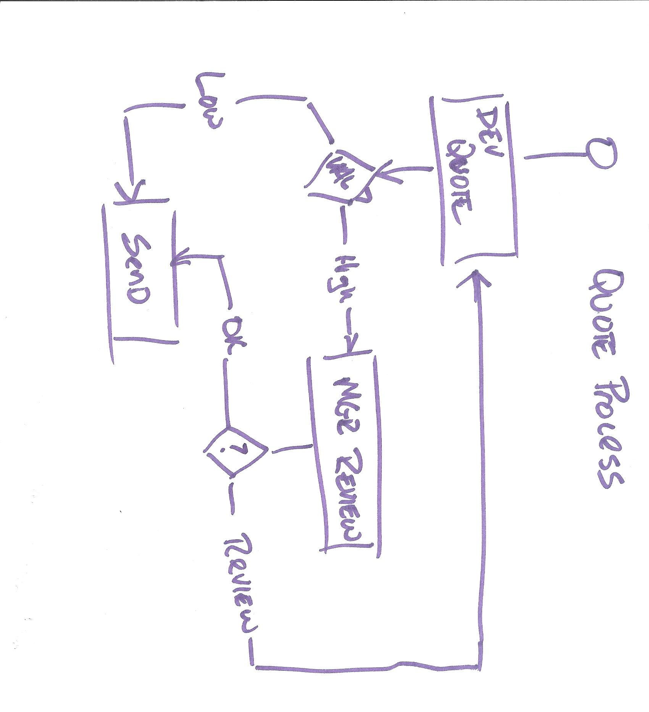

Slide 14
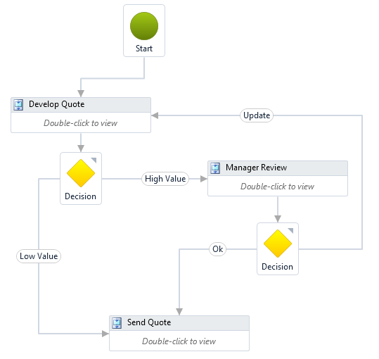

Slide 15
Flowchart vs. Procedural Style
While
Develop
Quote
Develop
Quote
Manager
Review
If-Else
Manager
Review
Send
Quote
Send
Quote

Slide 16
Hello Flowchart
Demo

Slide 17
Workflow Services
Services provide communication among application nodes
Service
Activity
Service
Activity
Activity
Service
Activities provide implementation of application nodes

Slide 18
HR Application Process
Education
Service
Applicant
1
Applicant
Service
HR Data
2
Persistence
5
3
4
Reviewer

Slide 19
Workflow Services
Demo

Slide 20
Windows Server AppFabric
Windows Server
Evolution of WAS/IIS and Windows Application Server role to run and manage WCF and WF services
Ships as part of 2010 Wave
Windows Server AppFabric
Management Tools
IIS Manager Modules
PowerShell
Services
Workflows
Persistence
Hosting
Monitoring
Caching
.NET Framework
Runtime Databases
Persistence
Monitoring
IIS/WAS

Slide 21
AppFabric Windows Server and Windows Azure platform
AppFabric
CACHING
WORKFLOW HOSTING
MONITORING
SERVICE BUS
SERVICE HOSTING
ACCESS CONTROL
HIGH AVAILABILITY
SCALE OUT
MULTI-TENANT
MANAGEMENT

Slide 22
AppFabric
Demo

Slide 23
Windows AppFabric Caching
Users
…
Web Tier
(ASP.Net)
Application
Application
Application
Caching Access Layer
Caching Access Layer
Caching Access Layer
Database
Cloud
Data Tier
Caching Service
Caching Service
Caching Service
Cache Tier

Slide 24
Summary
WF4 allows you to model business processes and can be used in any .NET process
Workflow Services and AppFabric allow you to create highly scalable and manageable services

Slide 25
For More Information
MSDN Workflow Dev Center
http://msdn.microsoft.com/wf
MSDN WCF Dev Center
http://msdn.microsoft.com/wcf
MSDN AppFabricDev Center
http://msdn.microsoft.com/appfabric

